Slide 1
Introduction to R Studio
R Studio 101
Single Variable Linear Regression
Multivariate Linear Regression
Forecast package - automated prediction

Slide 2
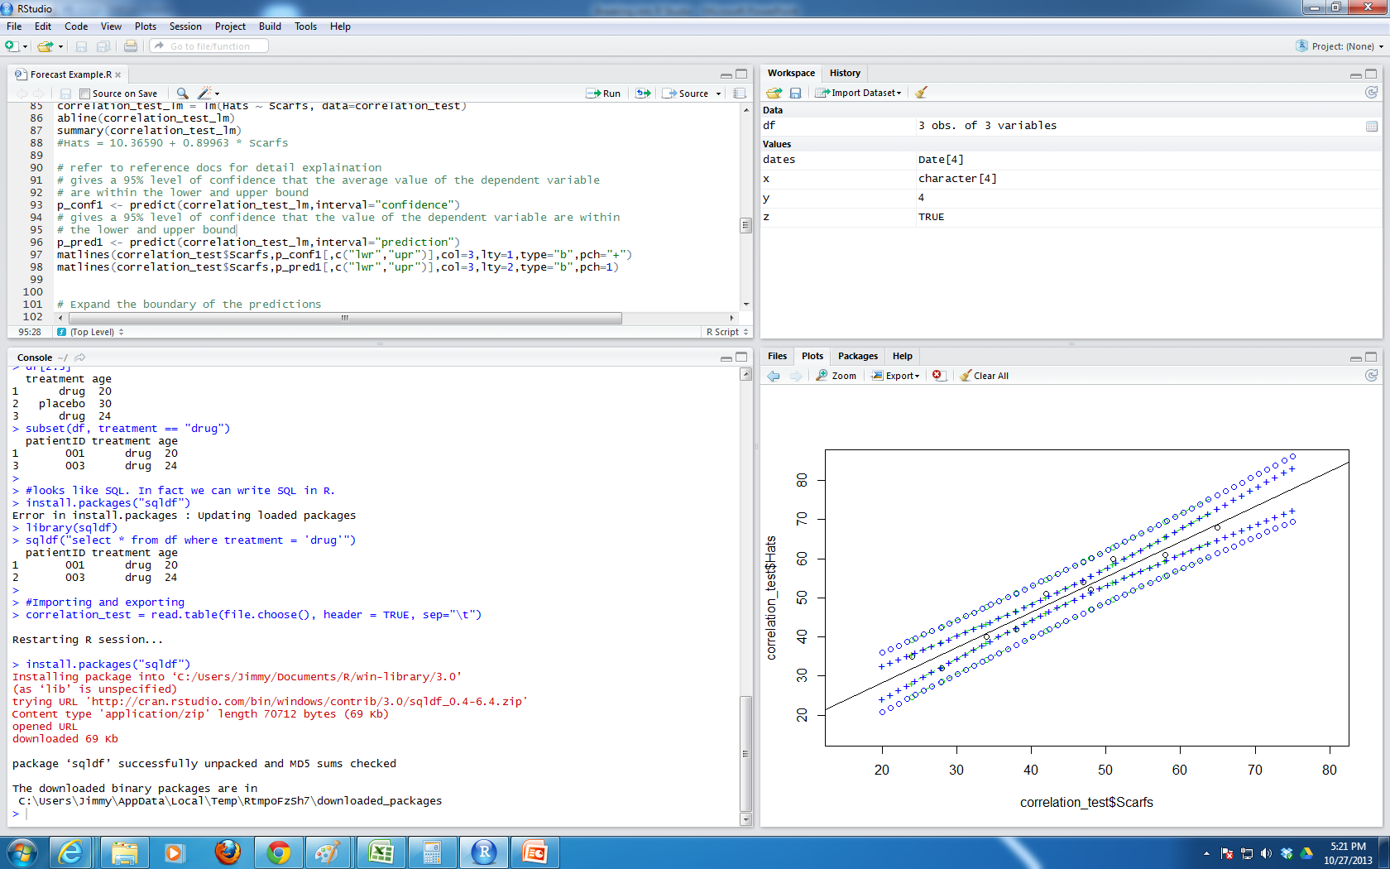
R Studio 101
Layout | Using SQL in R
R Studio 101 | Importing/Exporting
R data structures | Connecting to databases
Editor Window
Workspace Window
Command Window
Files / plots / packages /
help Window

Slide 3
Linear Model
Single variable Linear Regression
Correlations
Creating a model (Y = a + bX)
Predictions
Plot
Multivariate Linear Regression
Creating a model (Y = a + bX + cZ + dT …)
Prediction

Slide 4
Forecasting Package
Why use the forecasting package?
Walkthrough

Slide 5
References
Reference | URL
Oracle database interface for R | http://cran.r-project.org/web/packages/ROracle/index.html
Free public data | http://stackoverflow.com/questions/381806/large-public-datasets/381834#381834
Linear Regression Model video 1 | http://www.youtube.com/watch?v=bfGhfalZR-Y
Linear Regression Model video 2 | http://www.youtube.com/watch?v=itEyHjNjMIc
Confidence vs Prediction Intervals | http://www.youtube.com/watch?v=qVCQi0KPR0s
Linear Regression Model warnings | en.wikipedia.org/wiki/Anscombe's_quartet
Multivariate Linear Refression video | http://www.youtube.com/watch?v=Ktks5K95uQM
Forecasting Video | http://www.youtube.com/watch?v=1Lh1HlBUf8k
Forecast Crane page | http://cran.r-project.org/web/views/TimeSeries.html
K-mean Clustering | http://mathbabe.org/2012/09/27/columbia-data-science-course-week-4-k-means-classifiers-logistic-regression-evaluation/
Standford R studio Intro | http://www.youtube.com/watch?v=HKjSKtVV6GU

